Slide 1
Alzheimer’s stage classifier using a cnn.

Slide 2
PROBLEM STATEMENT
Alzheimer’s is a neurodegenerative disorder that primarily affects memory, thinking and reasoning skills.
Early detection is crucial for determining disease management since there is currently no cure.
MRI imaging is used as a non-invasive way of observing changes within the brain.
Manual diagnosis is often time-consuming and require experts in the field to analyze the scans.

Slide 3
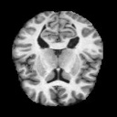
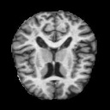
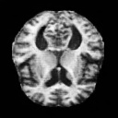
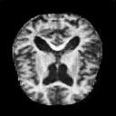
4 Stages of Alzheimer’s progression:
No Impairment
Very Mild Impairment
Mild Impairment
Moderate Impairment

Slide 4

SOLUTION OVERVIEW:
This project aims to utilize a Convolutional Neural Network (CNN) to develop a model that can classify a brain MRI scan into one of the four stages of Alzheimer’s.
It employs multi-class classification to allow the model to learn and assign a scan to one of the four categories.
Due to the large nature of MRI images and the use of floating-point operations for its analysis, this project is not yet ready to be deployed on a microcontroller.
Solutions such as model quantization and image downsampling will be discussed further.

Slide 5
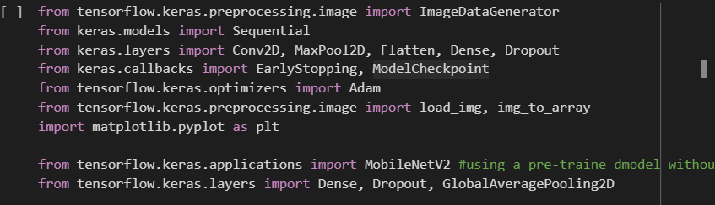
DATA LIFECYCLE: ACQUISITION
This implementation uses Luke Chugh’s Alzheimer’s MRI Dataset which was found on Kaggle.
It was downloaded imported into a Google Colab notebook.
The following libraries were also imported:

Slide 6
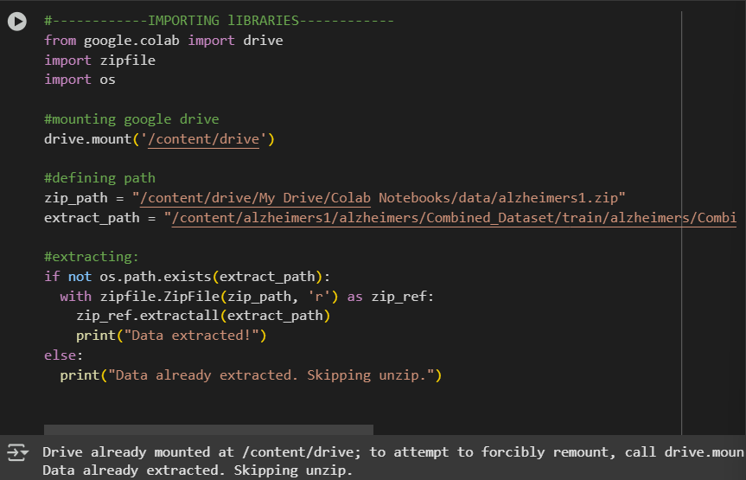
DATA LIFECYCLE: ACQUISITION
Image 1 showing the file import.

Slide 7
DATA LIFECYCLE: CLEANING AND PRE-PROCESSING
The data was normalized by rescaling the image pixel values from (0-255) to (0-1) by using rescale = 1./255
All images were resized to uniform shape of 244 by 244 pixels which is the required input size for the pre-trained MobileNetV2 which is designed for image classification.
The data was then split into training and validation sets of 80% and 20% population, respectively.
The data in these sets was then augmented with random image alterations such as rotations and flips to help improve the model’s generalization.

Slide 8
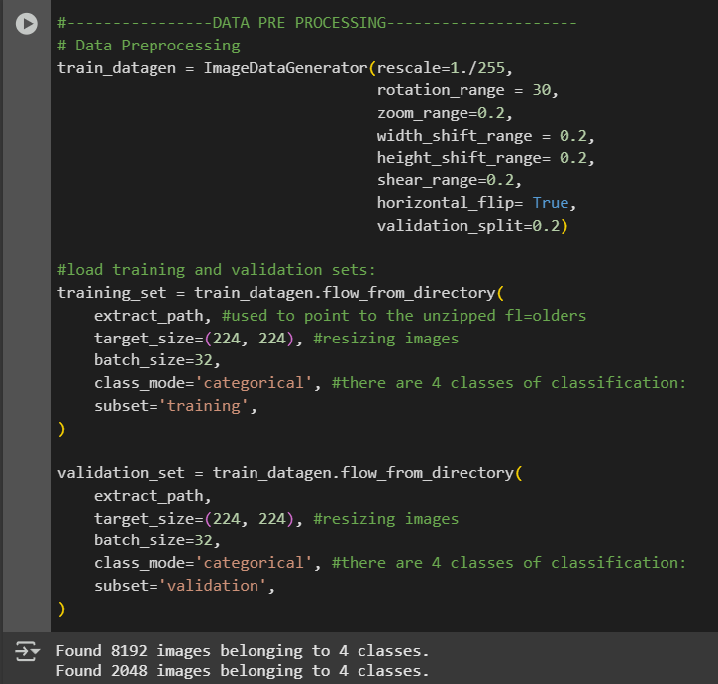
DATA LIFECYCLE: CLEANING AND PRE-PROCESSING
Image 2 showing the data pre-processing.

Slide 9
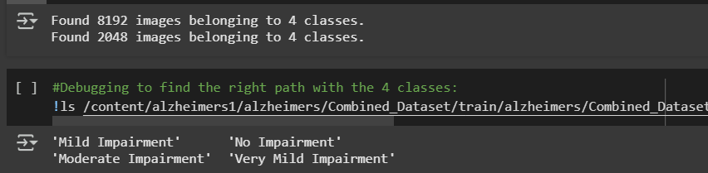
Labeling & CONSTRAINTS
Labels were automatically assigned by using train.datafen.flow_from_directory() when splitting the trinaining and validation sets.
This allowed for the categories to have the same name of the folders they were initially divided into.
The dataset requires a lot of memory and GPU resources which can be costly.
Variations such as scan quality and brightness may introduce noise to the model.
The model is currently too large for TinyML deployment.

Slide 10
MACHINE LEARNING APPROACH
WHY A CNN?
A Convolutional Neural Network (CNN) was used process this dataset because it is designed to process grid-like structures, such as images.
Convolutional layers allow neural networks to automatically learn spatial patterns from image data, thus, making it an appropriate maethod of interpreting MRI images.
It captures low-level features in early layers and progressively learns more abstract concepts in deeper layers.
ARCHITECTURE:
Instead of building the CNN from scratch this implementation uses the pre-trained MobileNetV2 as the base model.
Uses the Keras API which runs as a part of the TensorFlow ecosystem.
The original classification head (final layers of the model which includes the output layer) was removed and replaced.
Employs a Fine-Tuning Architecture with early stopping.

Slide 11
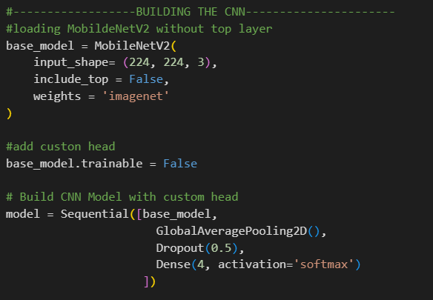

Slide 12
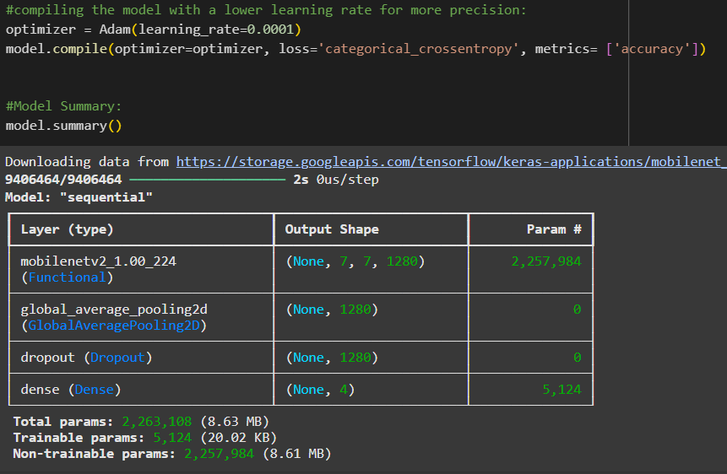

Slide 13
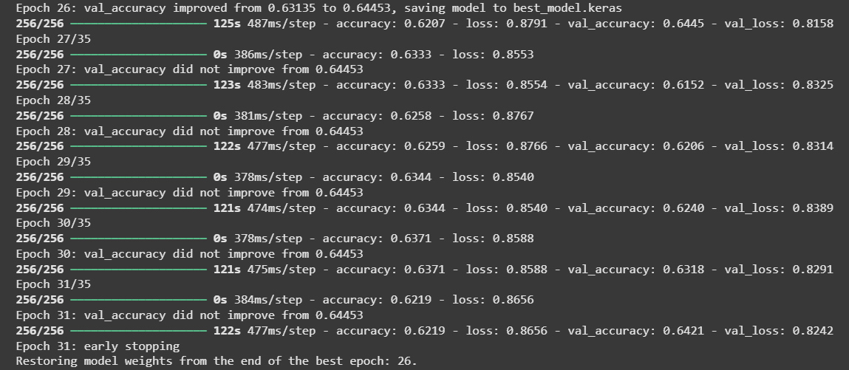
MODEL TRAINING

Slide 14
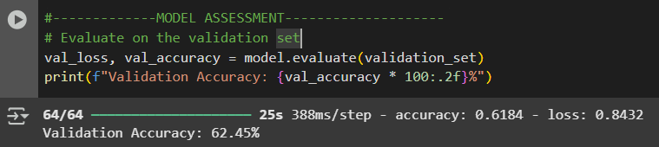
MODEL ASSESSMENT
Model performance was measured based on accuracy/loss since medical diagnoses rely more on false positives and false negatives than overall correctness.

Slide 15
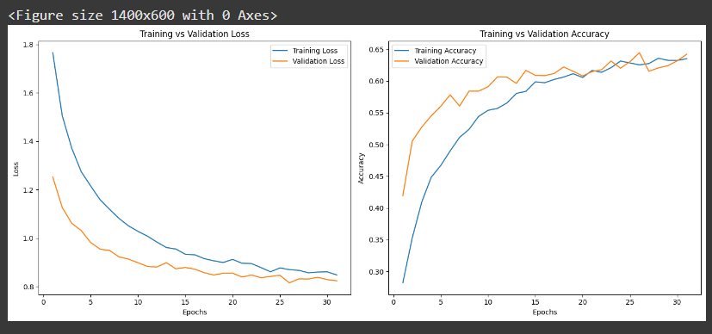

Slide 16
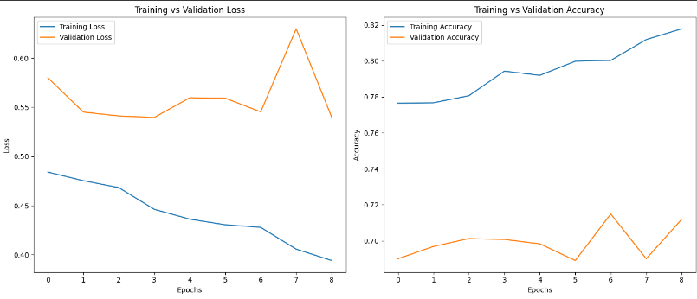
Without mobilenetv2:

Slide 17
TINY ML DEPLOYMENT
Model needs to be quantize, ModelNetV2 is a start since it is a light architecture.
Currently, the model is too large (224 x 224) is not desirable for microcontroller deployment.
The model currently uses Keras which can be converted to TensorFlow Lite.

Slide 18

Thank you
Aruna Dookeran
adookeran2022@my.fit.edu

